Slide 1

Togepedia
Notes:
We are the morning-10 group and today we are showcasing our website, Togepedia.
We will first introduce our members of our team.

Slide 2

Tristan McDaniel
Track:
Computer Architecture / Embedded Systems
Software Engineering
Responsibilities:
Development of Team Builder and About Us pages
Helped to setup database connection and queries
Created suite of backend tests

Slide 3
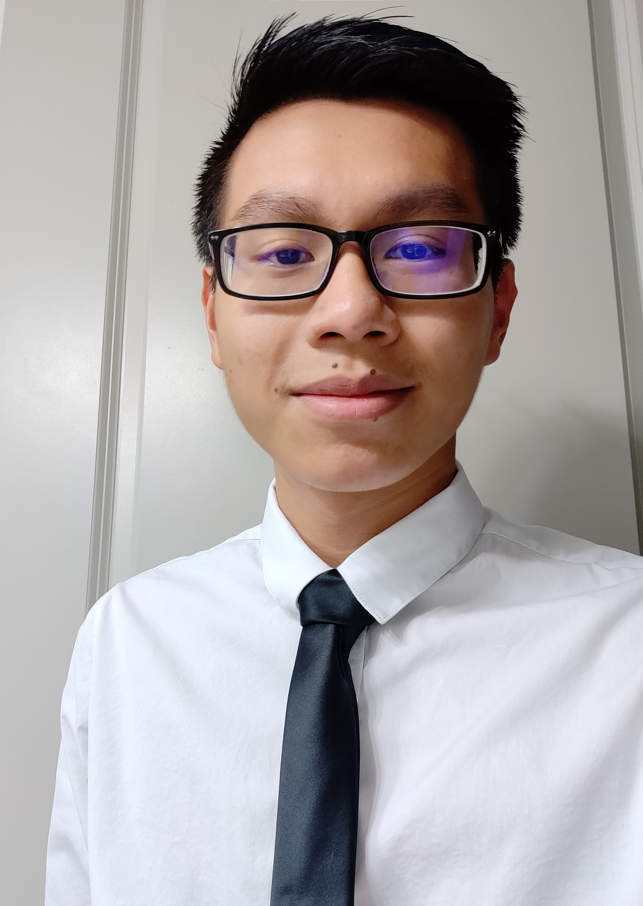
Jimmy Phan
Track:
Data Science
Academic Enrichment
Responsibilities:
Designed front end for model pages and the home page
Designed Info pages and linked together models
Styled website and deployed theme
Created pipeline for data fetching and rendering

Slide 4
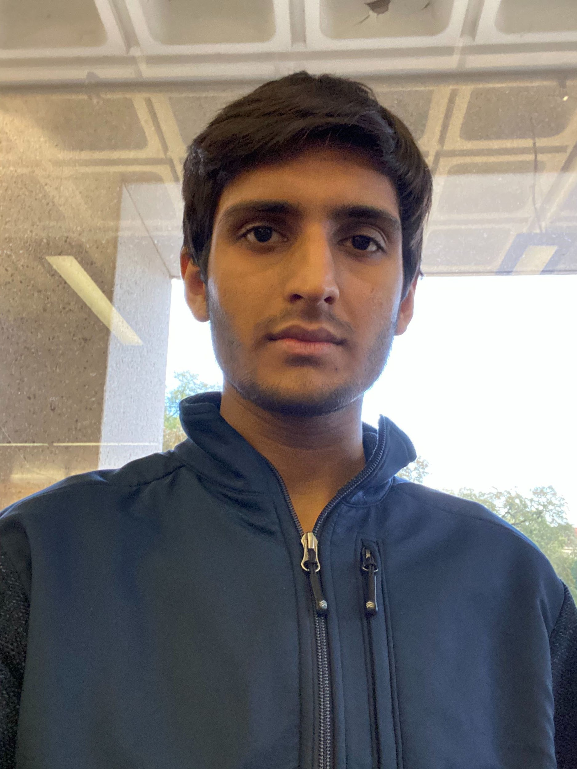
Mihir Shah
Track:
Computer Architecture / Embedded Systems
Integrated Circuits
Responsibilities:
Specified functional requirements for website
Created UML diagrams for the design of our website
Development of feedback page

Slide 5
Jaime Tan Leon
Track:
Software Engineering and Design
Academic Enrichment
Responsibilities:
Frontend for Moves, Abilities, Items, and Types page
Stored data into our MongoDB database
Created the routes to the backend database
Created test cases for frontend testing

Slide 6
Togepedia: A One-Stop-Shop for all your Pokemon needs
Notes:
Mihir -
Togepedia is a pokemon database where clients such as casual and competitive pokemon players can find information on all Pokemon, Items, Moves, Abilities, and Types.
The websites models are Pokemon, Moves, and Abilities that can all link to the other models.

Slide 7
Let’s take a look at Togepedia
Notes:
Show the front page, and navigate through the carousel
Show the Pokedex, show pages of a couple of Pokemon and use search, filter, and sort functionalities
Show the Moves, show pages of a couple of moves and use search, filter, and sort functionalities
Show the Abilities, show pages of a couple of abilities and use search, filter, and sort functionalities
Show the Items, show pages of a couple of items and use search, filter, and sort functionalities
Show the types page, show the chart, click on some types and show moves/pokemon with that particular type
Show teambuilder page, show how we can create a team
Show about us page
Show the feedback page

Slide 8
What went well?
Notes:
Jaime-
Good design with matching theme and minimalistic layout - colorful
Had extra pseudo models like items and types to make the database more connected
Good teamwork and transparency
Good separation of responsibilities in terms of frontend and backend

Slide 9
What can we improve upon?
Notes:
Jimmy
Team Builder
In its current state, team builder acts more as a proof of concept in which we strived to implement as many of the functionalities of Pokemon Showdown as possible. In the end, we can improve upon this page by adding support for multiple teams and allowing users to link their teams to their google accounts. We would also liked to have implemented more pokemon statistic editing and enhanced back-end logic to link variation of statistics like the level to other statistics.
Fetching
Speed up fetching - too slow
Sorting, Searching and Filtering techniques
Info page could have more content but time and data restrictions

Slide 10
What were some things we learned along the way?
Notes:
Mihir
During the development of this full-stack web application, each member of the team was able to get hands-on experience with every aspect of the website from defining queries to our database to developing in React. Many of the new tools that we were able to work with included React, Mongoose, npm, Express, Selenium, and many more.

Slide 11
Developer Critique
Notes:
Tristan -
Next, we will take a step back from our website and talk about our developer teams website. Overall, we can appreciate the usefulness that their website offers and like the character that the team added through memes on the front page. The website is easy to navigate and has a clean and simple interface. Linking between each model can be improved because the UI does not always denote clickable elements. Sorting could also be improved in the team model because it can be difficult at times to differentiate between different conferences. In the end, we appreciate some of the unique aspects of the website such as the listing of past basketball games while also noting that improvements could be made throughout the website. While going through their website, we learned that a simple interface and the addition of a next and previous button on pagination leads to a nice user experience.

